Slide 1
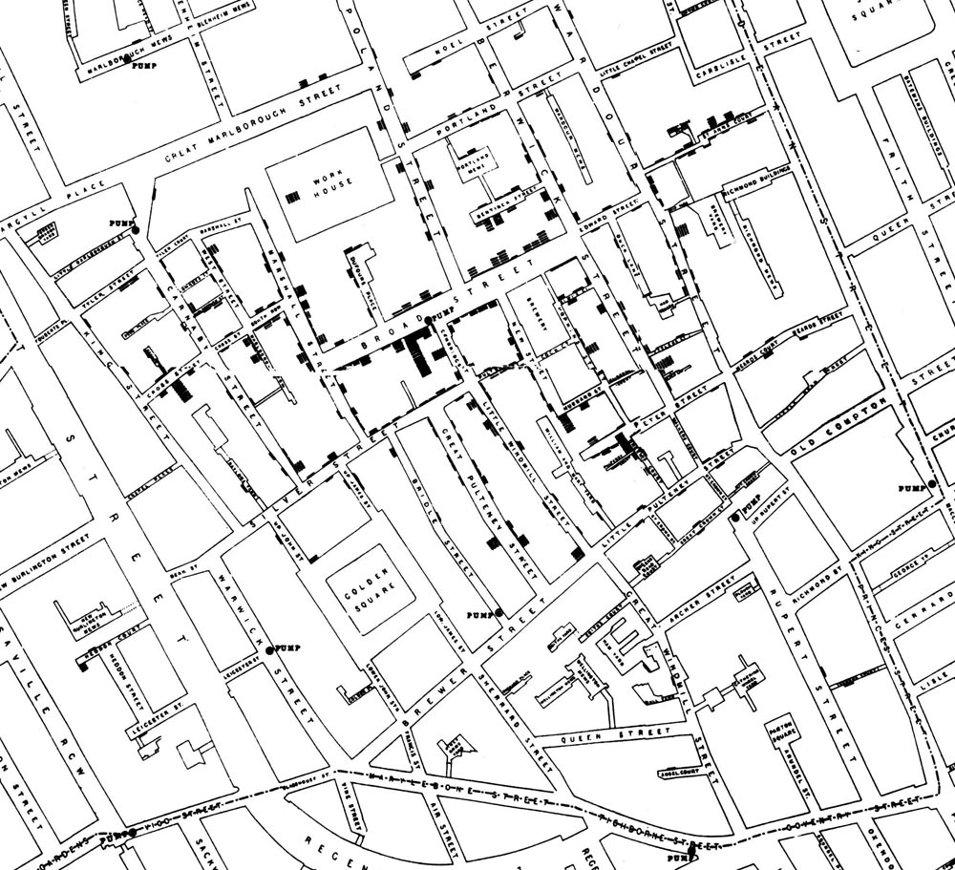

Slide 2
Plan for this week
Tuesday:
The Raster Data Model
Thursday:
Map Algebra
Local operations

Slide 3
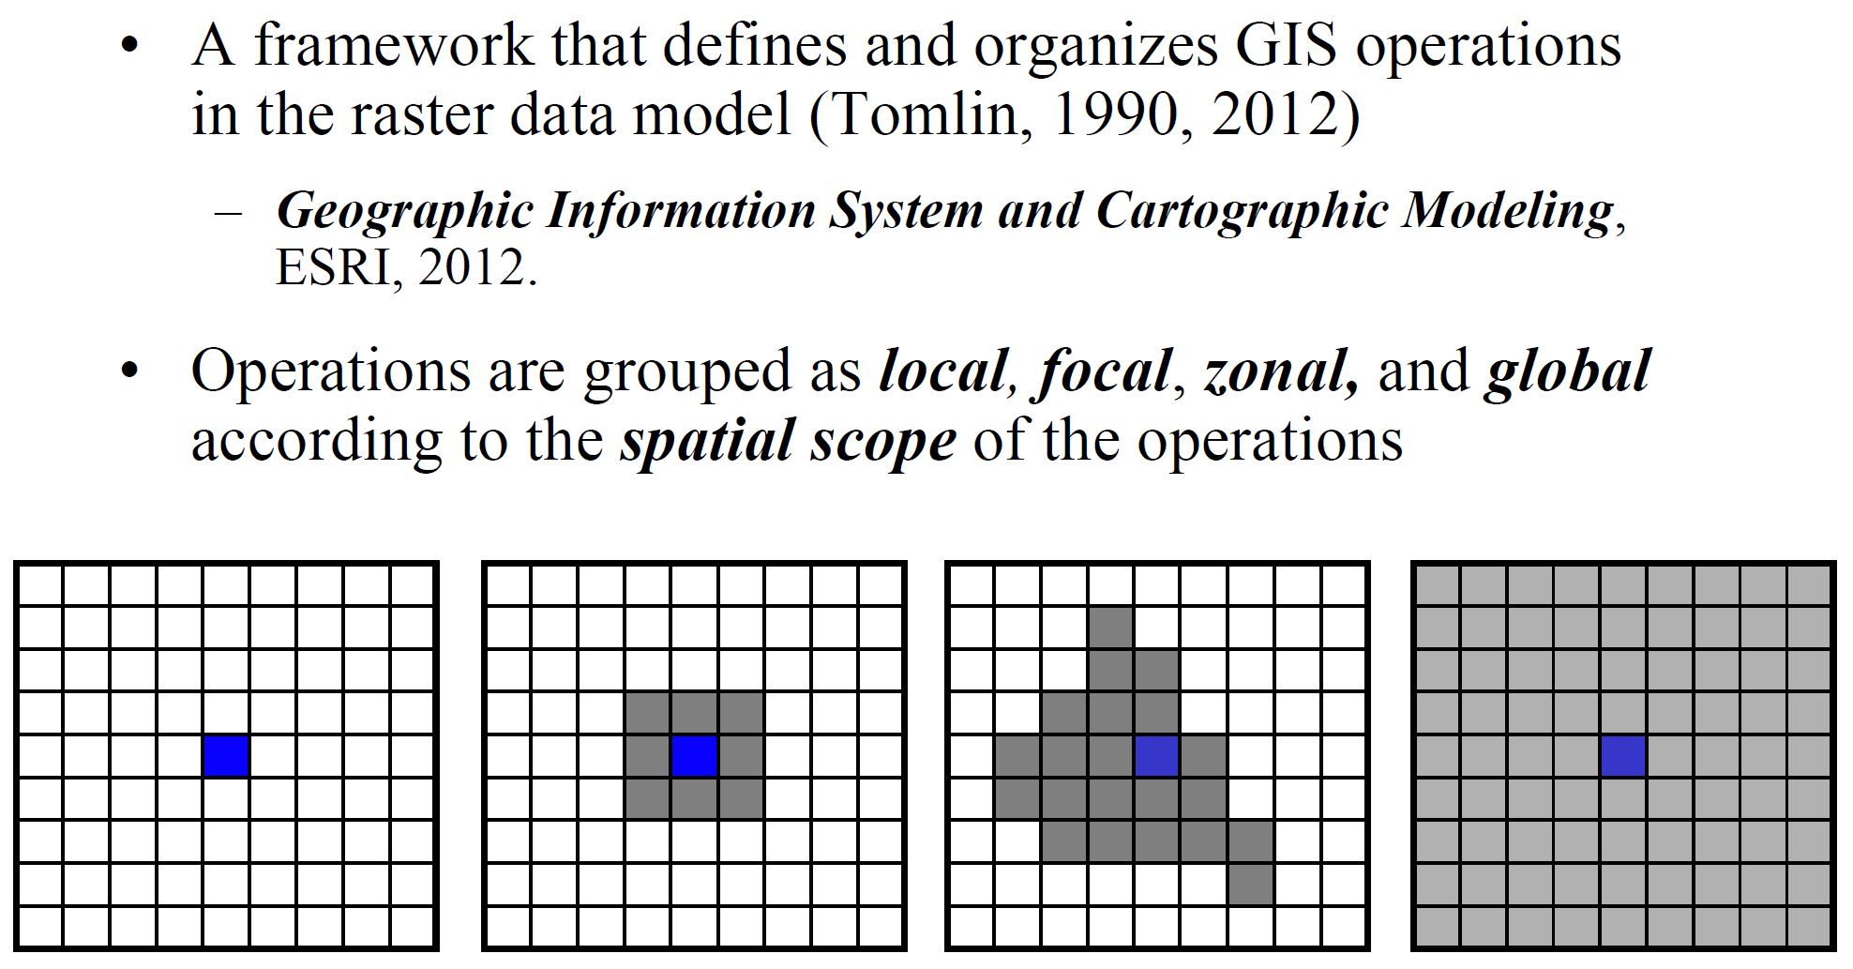
The Cartographic Modeling (Map Algebra) Framework

Slide 4
Spatial Analysis in the raster data model
New rasters are created by applying (functions/Cartographic modeling/map algebra) operations to input raster(s)
Layers are manipulated by math-like expressions to create new raster layers
Can be as simple or as complex as the operation calls for
Add 1 to all values
X = Y + 1
Solar radiation calculations
DirRad = S_{const} * ꞵ^{m(ø)} * SunDir(ø,a) * SunGap(ø,a) *Cos(AngIn(ø,a))

Slide 5
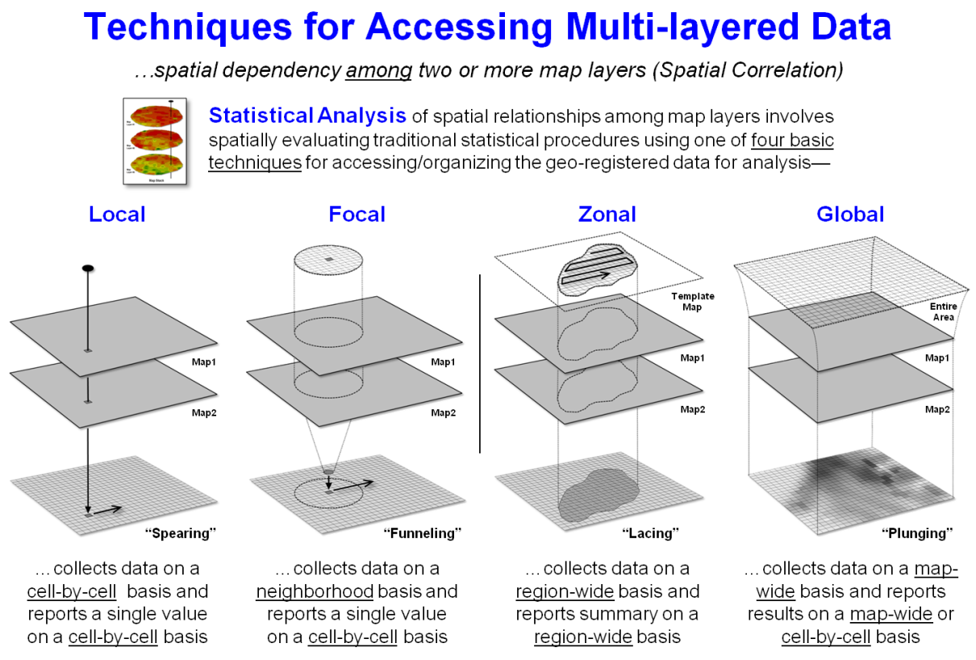
Local Operations

Slide 6
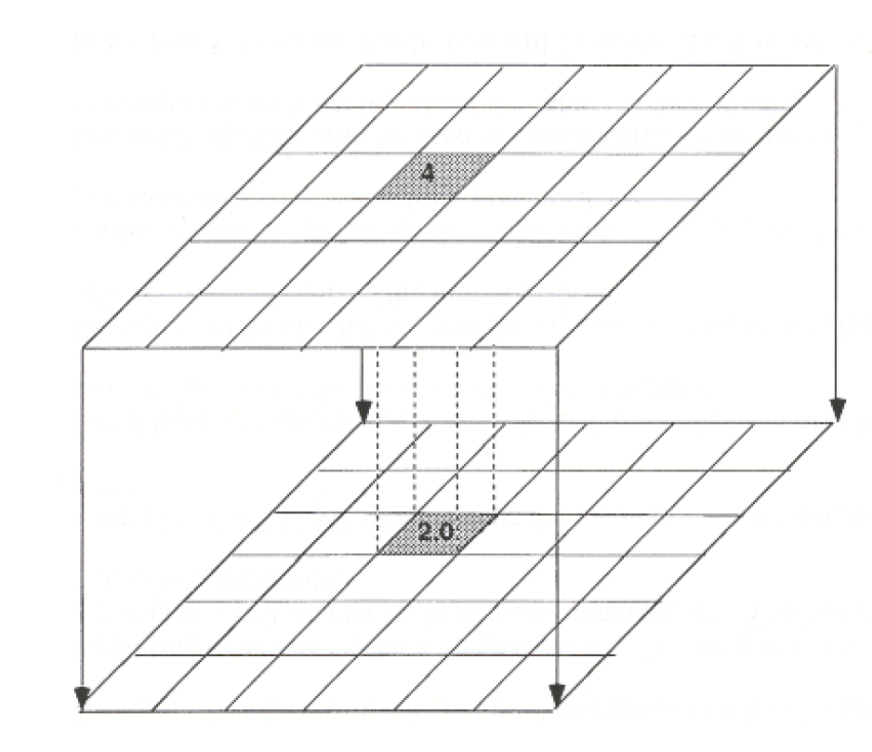
Local Operations
Computer a new raster layer
Generally accomplished via raster calculator in ArcMap
The value for each cell on the output layer is a function of one or more cell values at the same location on the input layers

Slide 7
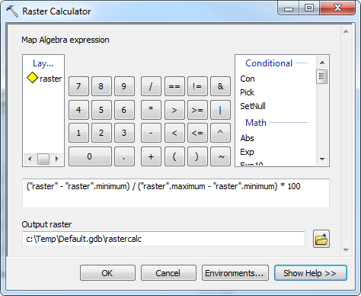
Local Operations

Slide 8
Local Operations
Types of operations:
Arithmetic Operations:
+,-,*,/,Abs(),….
Relational Operations :
>,<,...
Statistical Operations:
Min, Max, Mean, Mode,….
Trigonometric Operations:
Sin, Cos, Tan, ArcSine
Only Hippies Are Happy On Acid
Exponential and Logarithmic Operations:
Sqr, sqrt, exp, pow, e

Slide 9
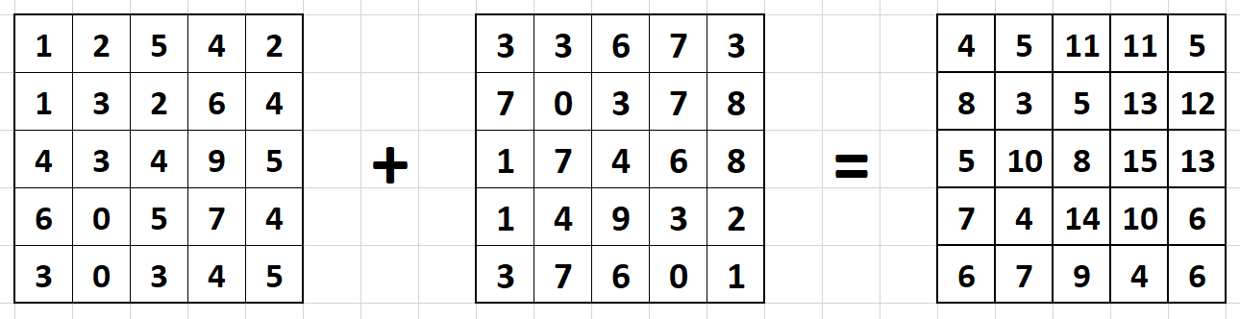
?

Slide 10
!GIS!

Slide 12
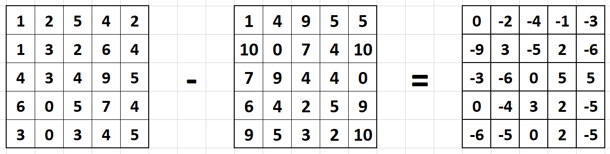

Slide 13
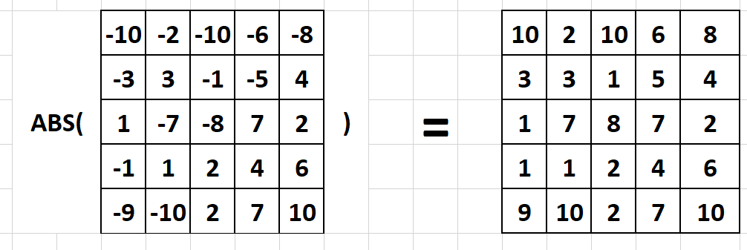

Slide 14
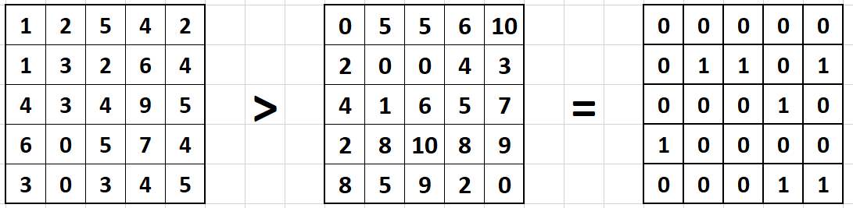

Slide 15
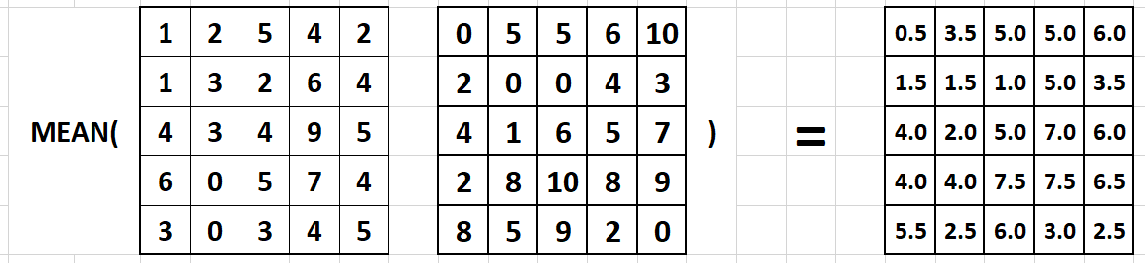

Slide 16
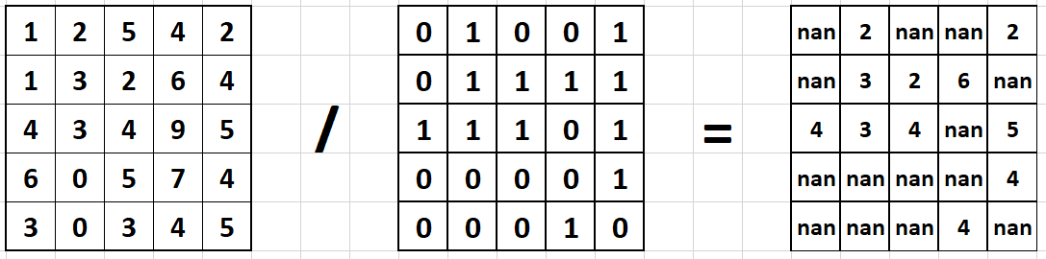

Slide 17
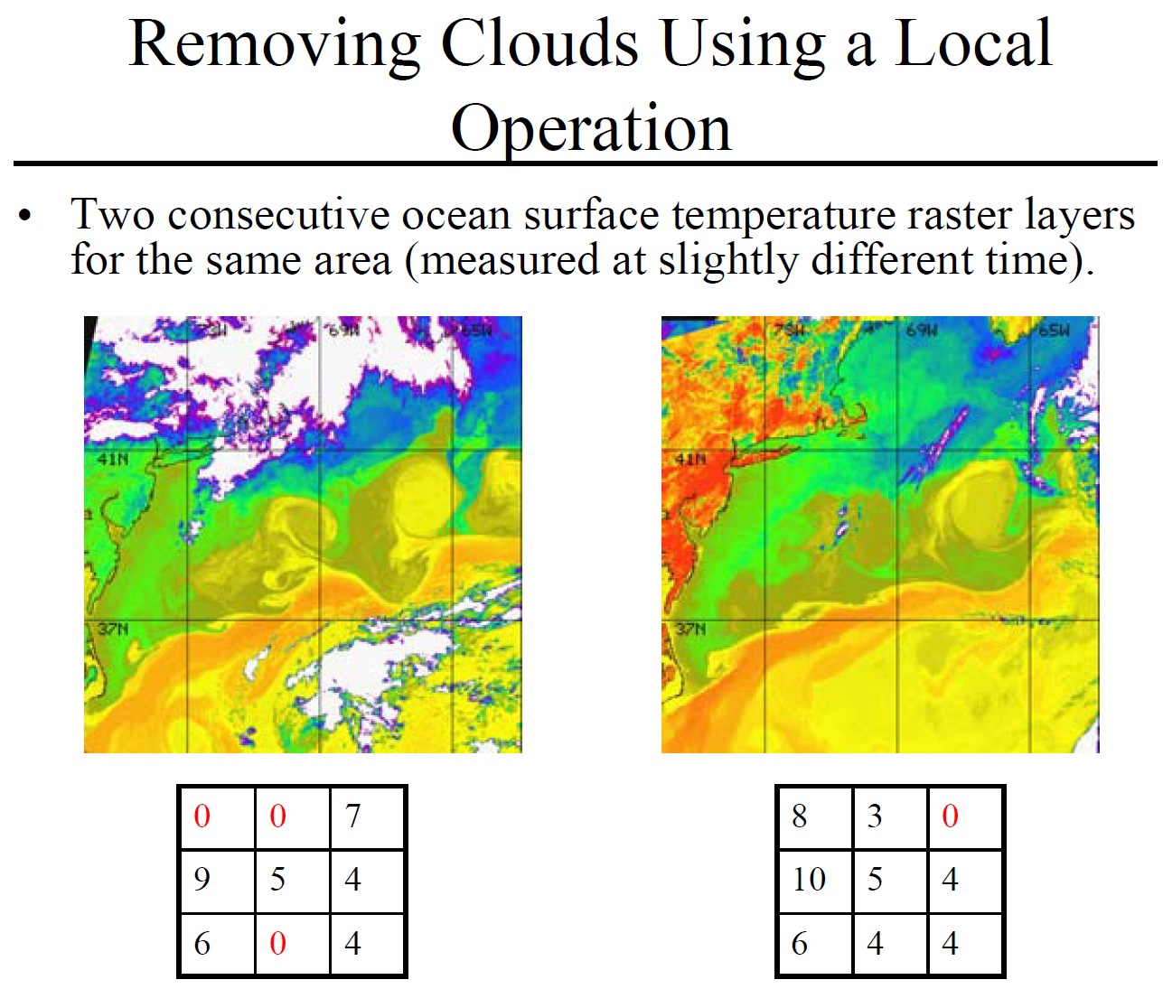

Slide 18
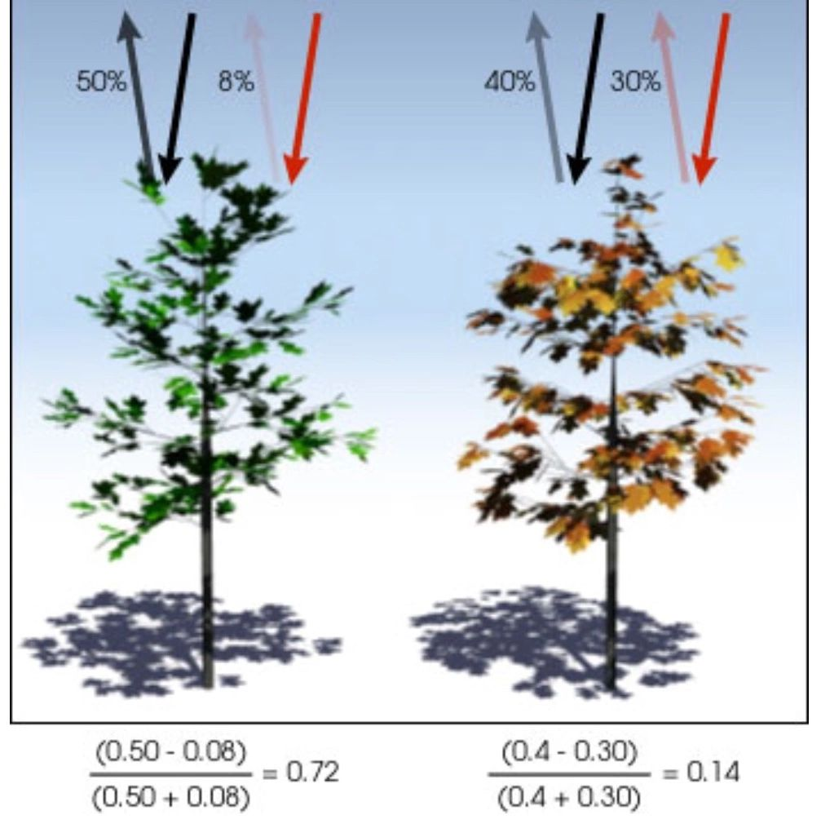

Slide 19
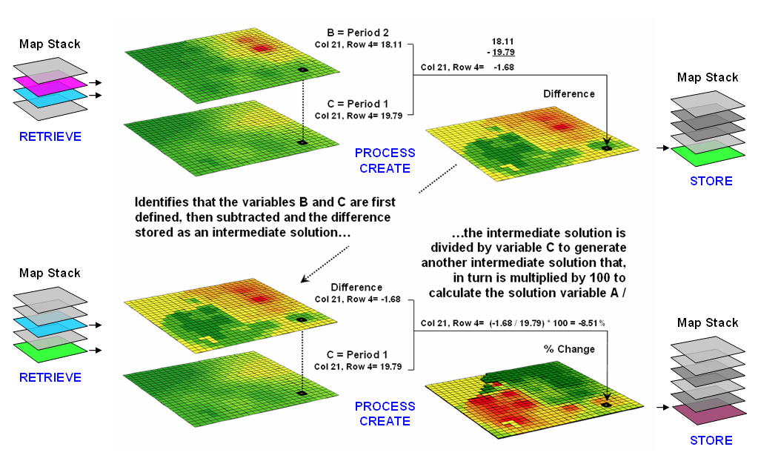
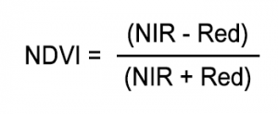
Example: NDVI Change

Slide 20
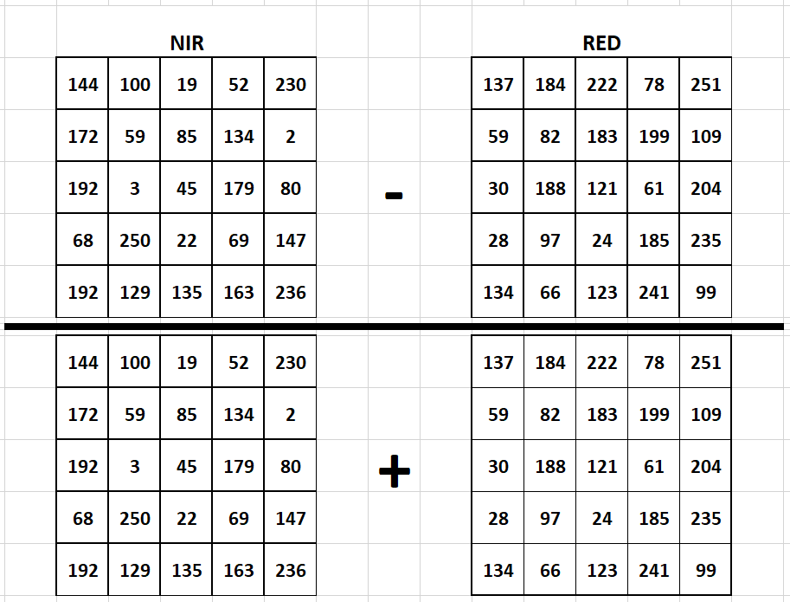

Slide 21
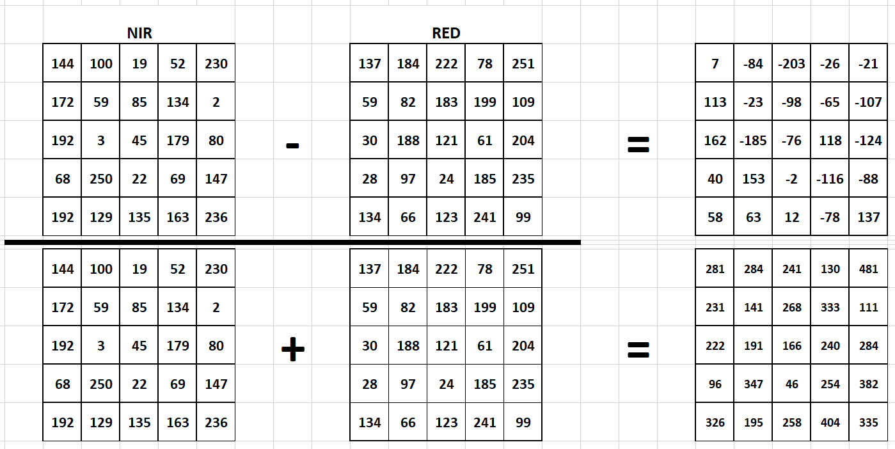

Slide 22
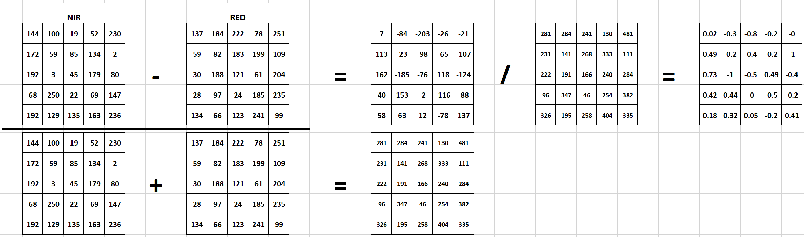

Slide 23
Lab applications
Part 1: Reservoir Volume Estimation
Part 2: Basic Habitat analysis

Slide 24
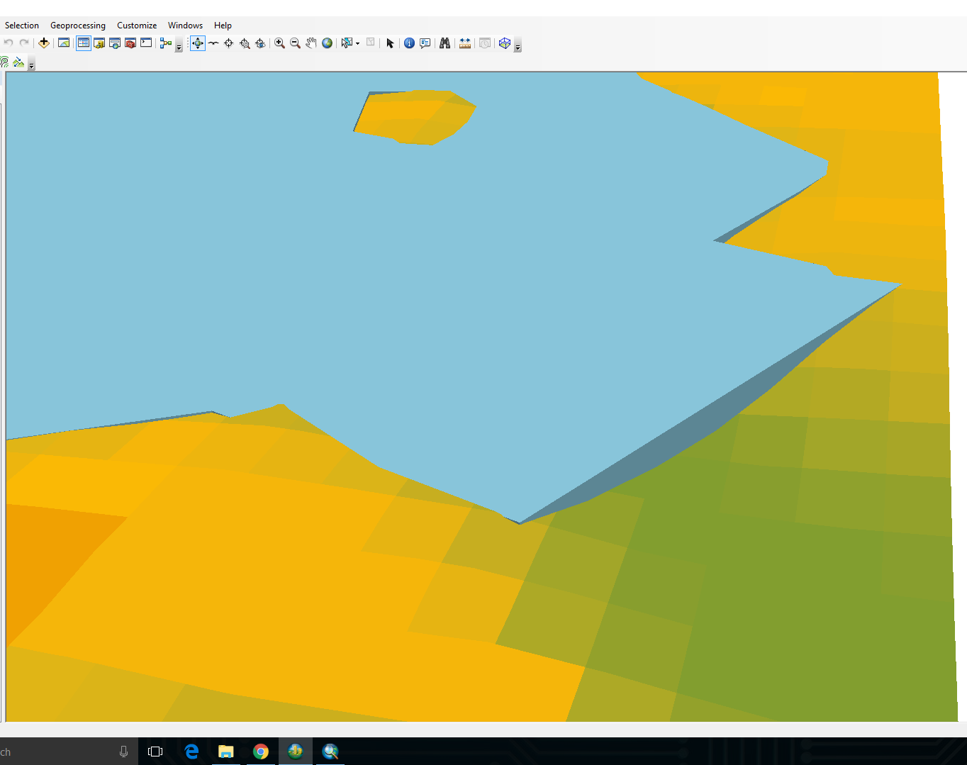


Slide 25
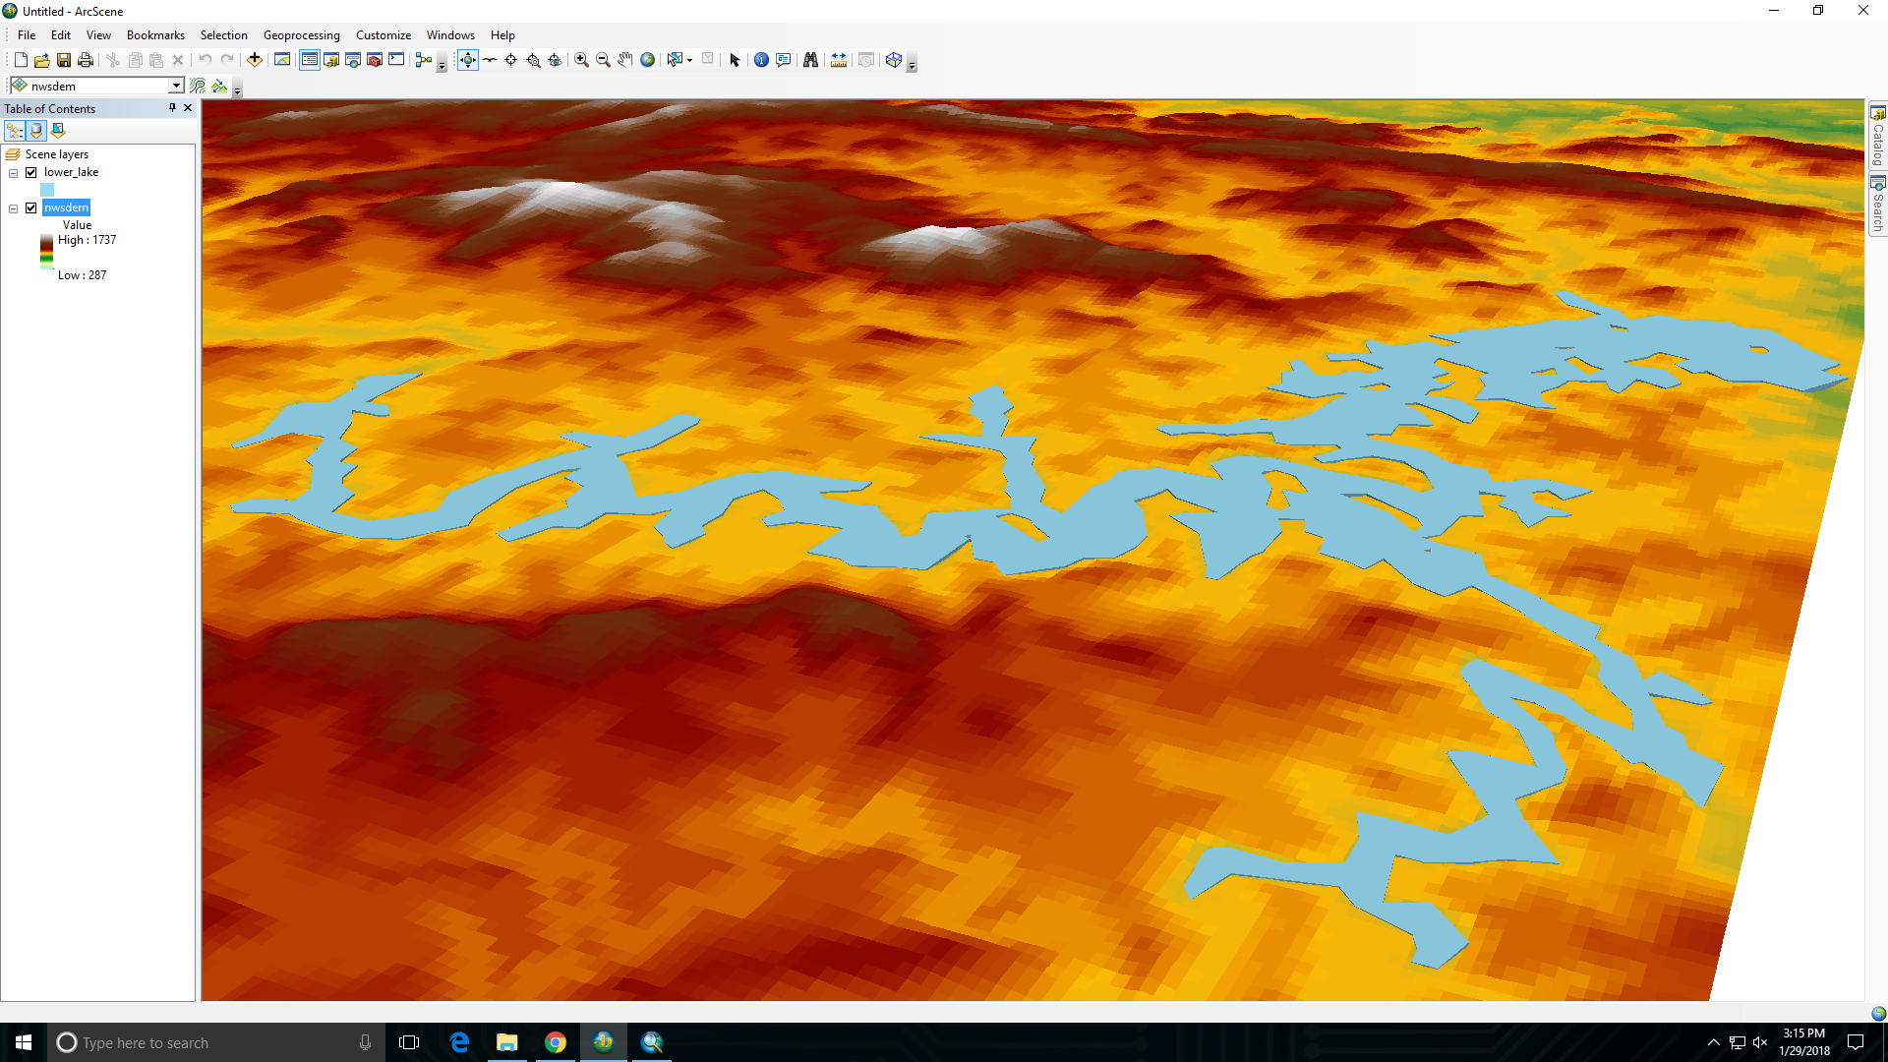

Slide 26
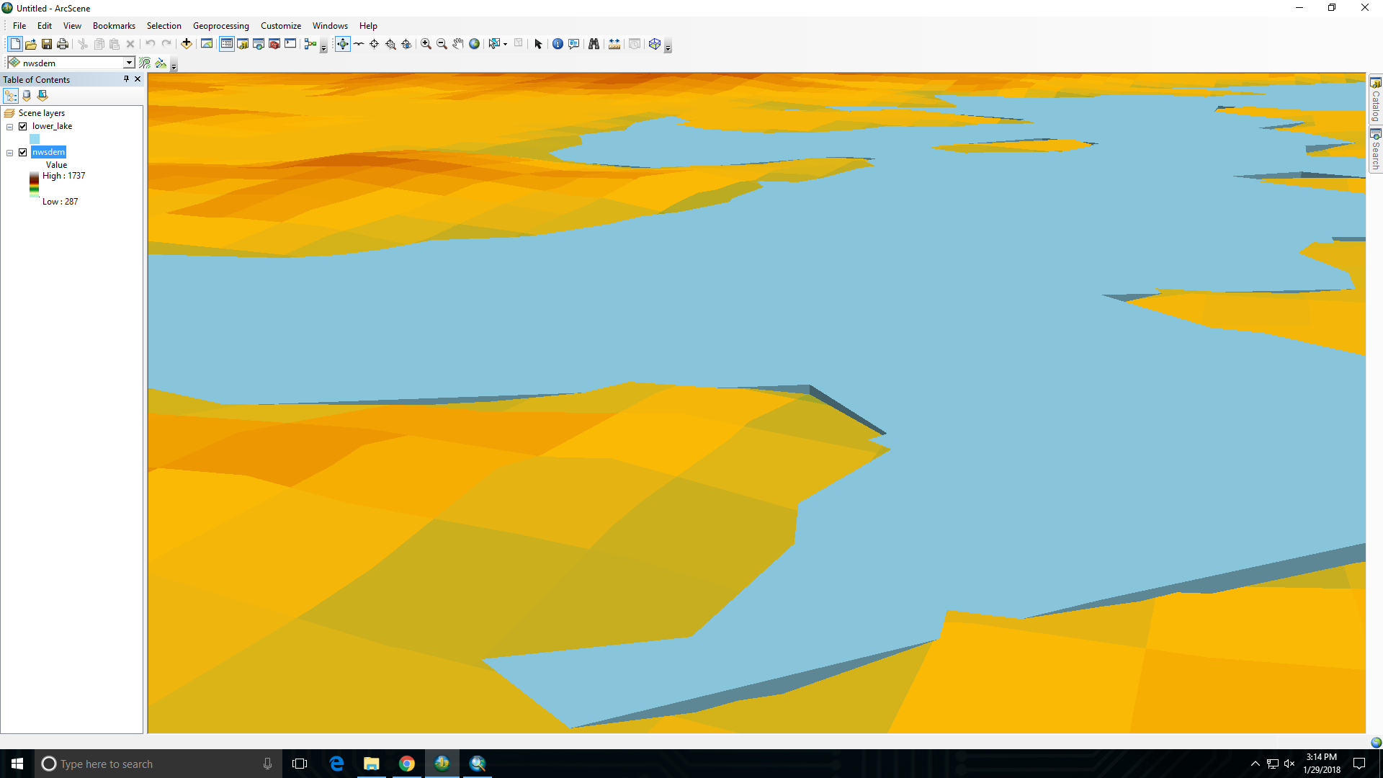

Slide 27
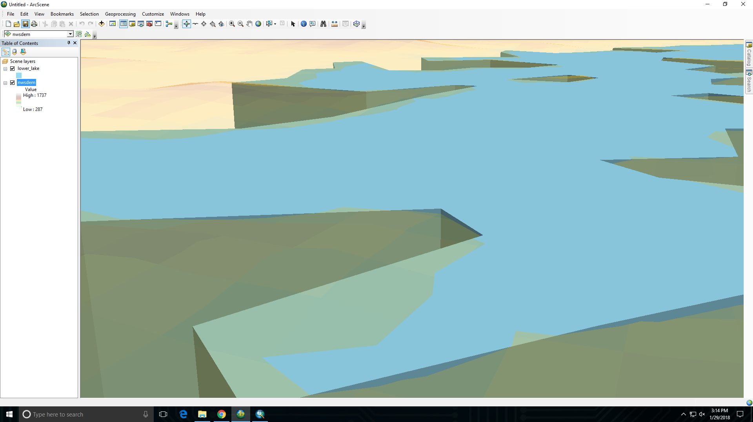

Slide 28
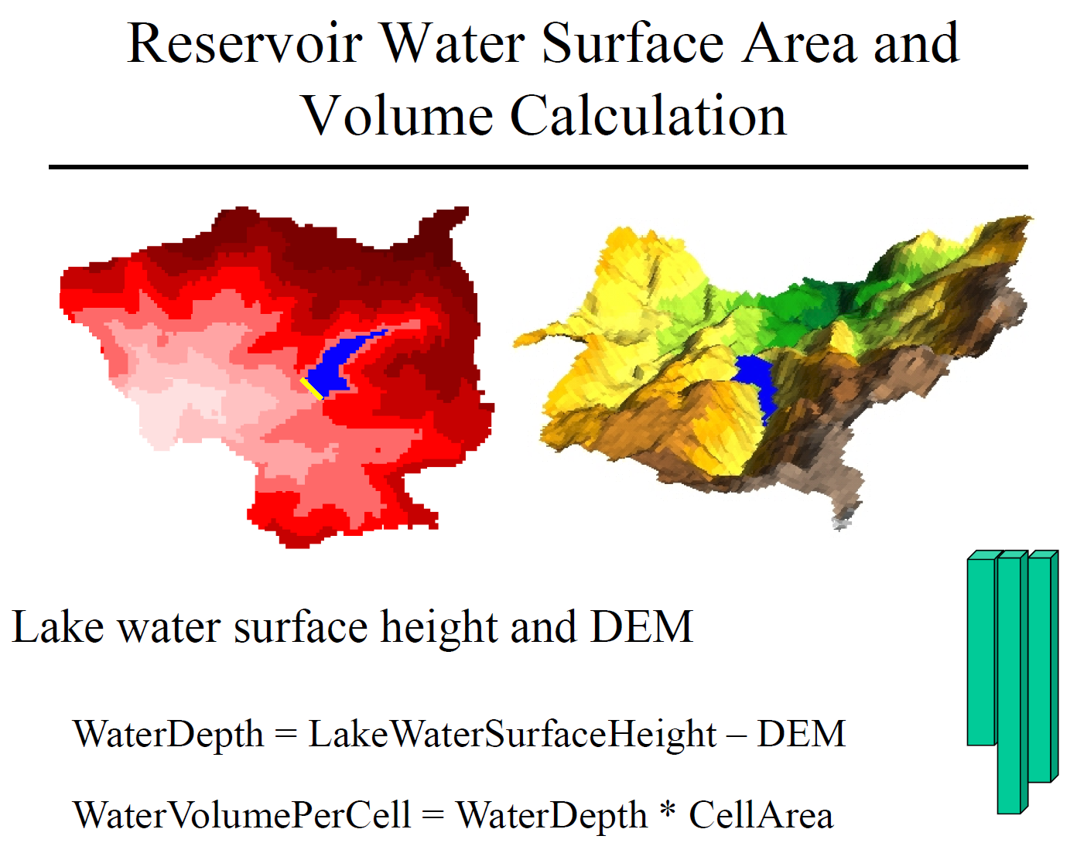

Slide 29
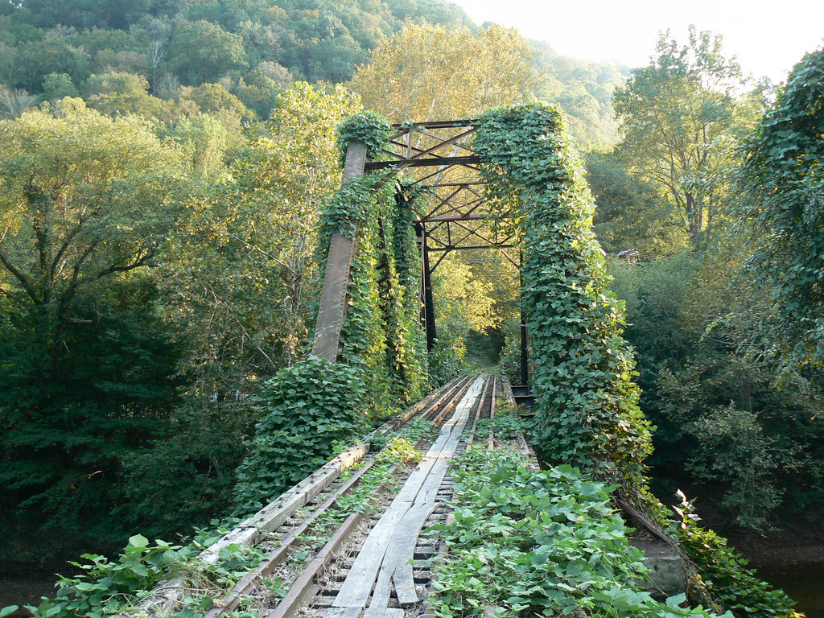

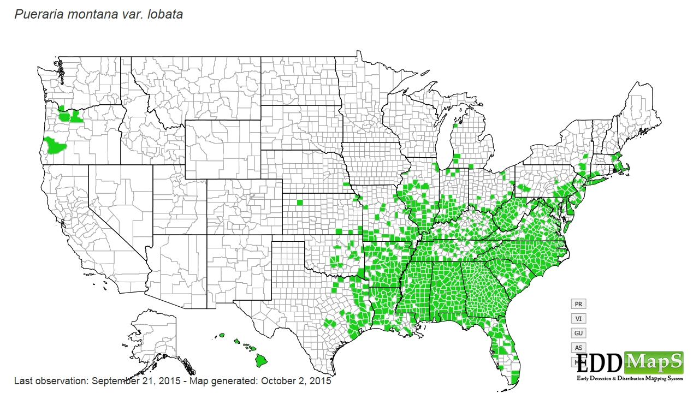
Lab Part 2: KUDZU

Slide 30
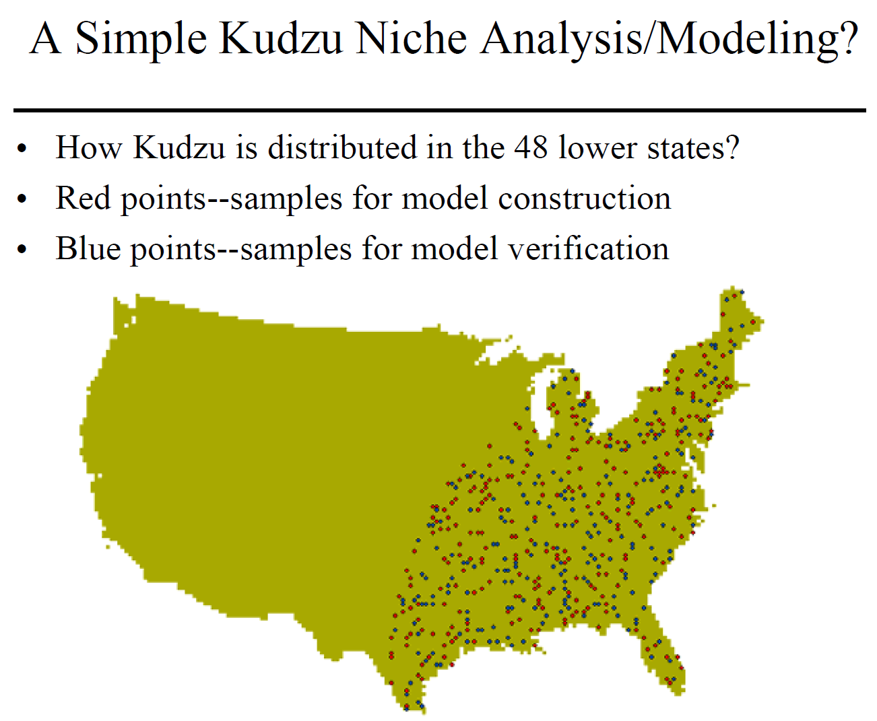

Slide 31
KUDZU NICHE ANALYSIS/MODELING
Environmental variables that may control Kudzu distribution
Water – The Kudzu vine can not swim
Precipitation – Kudzu need a certain amount of precipitation in order to germinate
Frost free days – Kudzu needs a certain number of frost free days in order to grow
Construct a simple model
Not in water
≥ minimum precipitation
≥ minimum frost free days

Slide 32
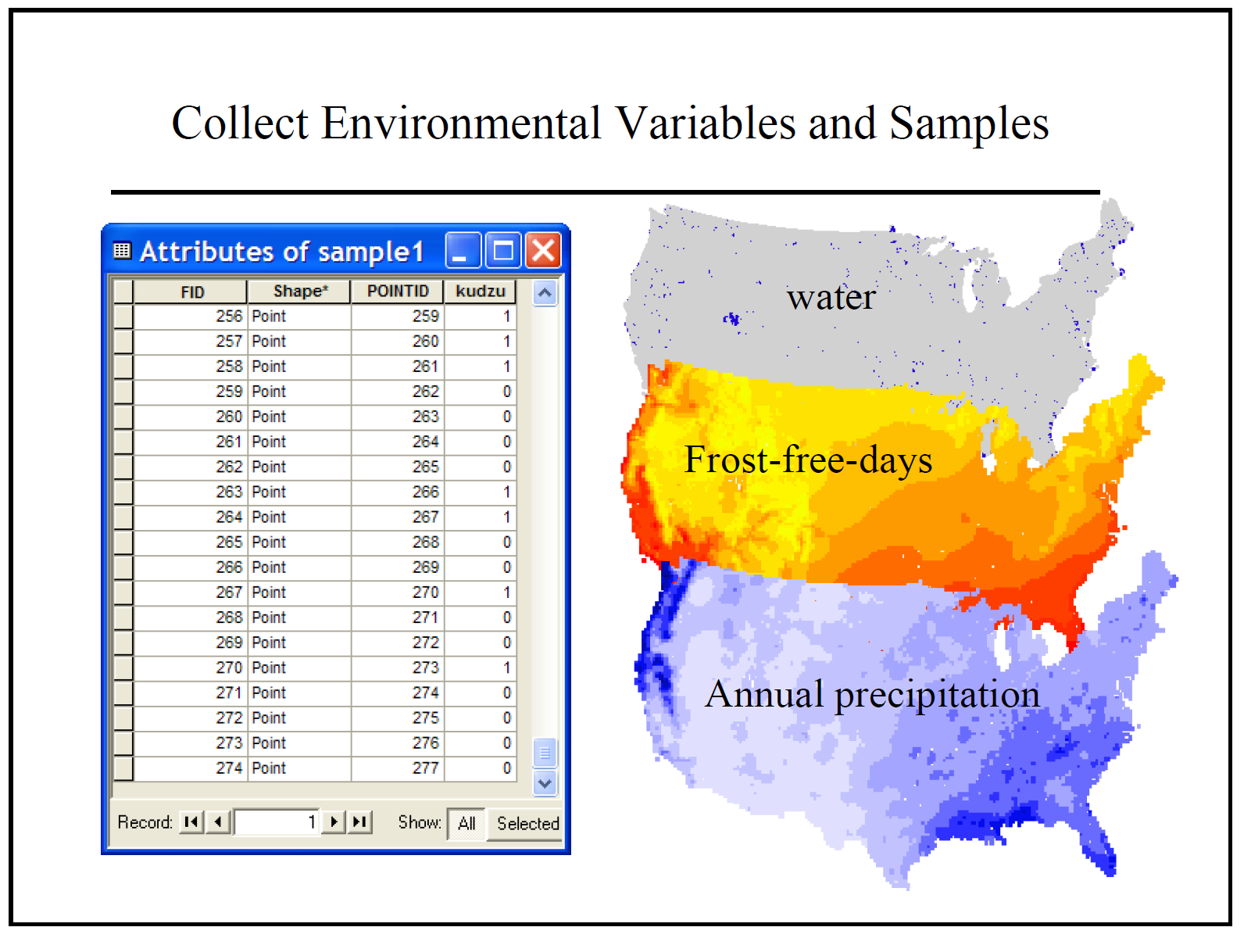

Slide 33
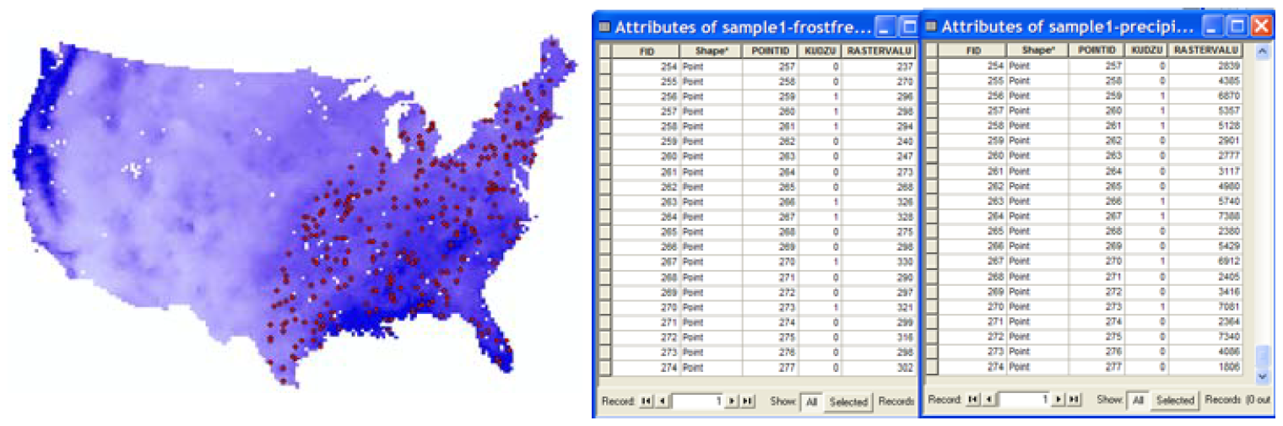
Model construction
Extract frost free days and precipitation amounts for the observation points
(extract values to points) / (extract multi-values to points)
Find the minimum values
Identify where those conditions are met
Raster Calculator
Perform an accuracy assessment

Slide 34
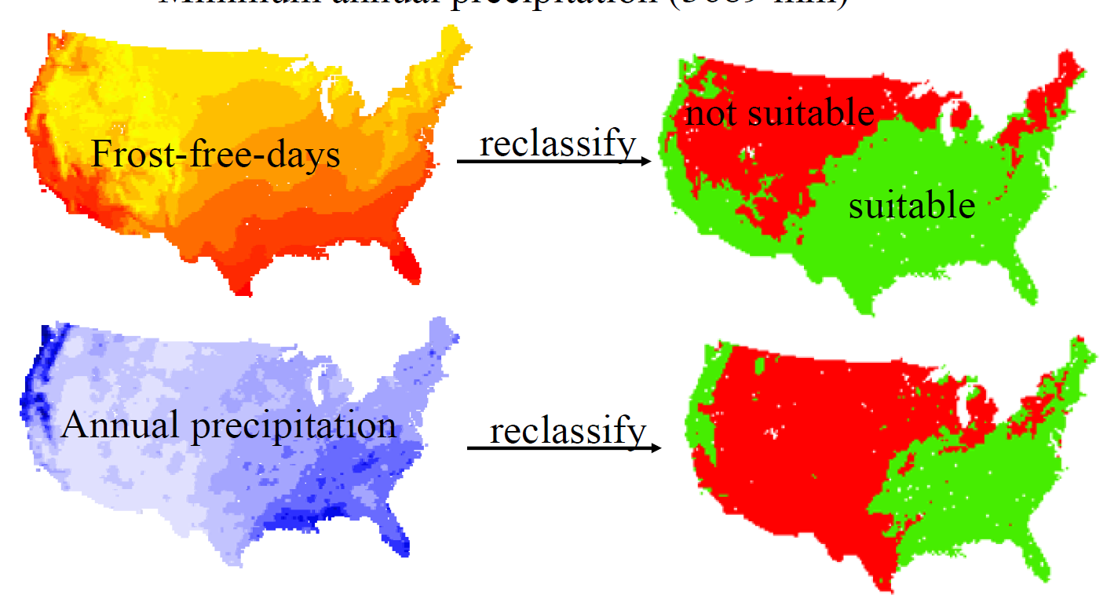

Slide 35
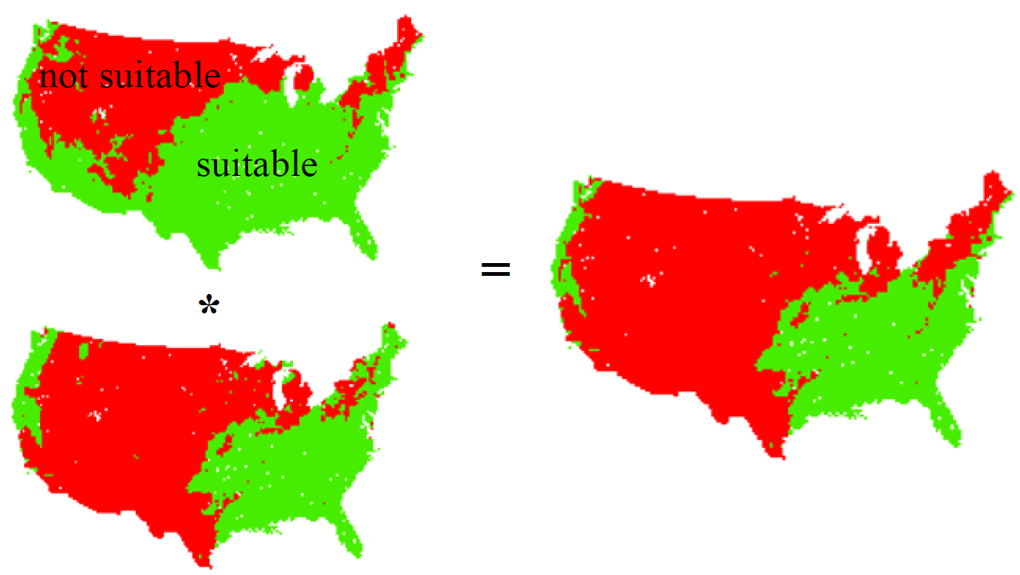

Slide 36
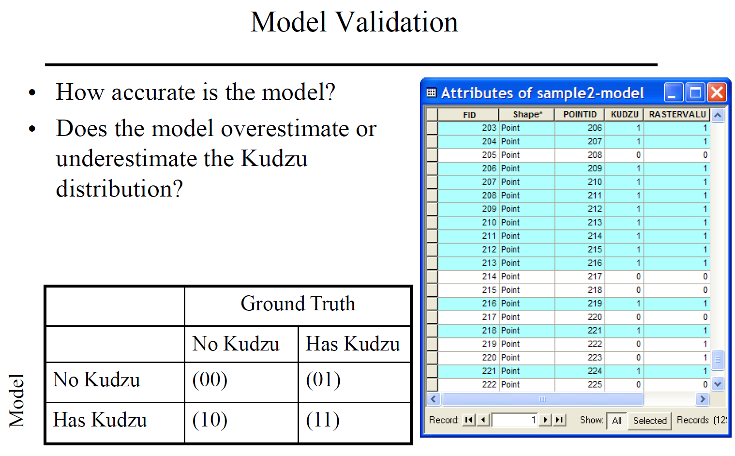

Slide 37
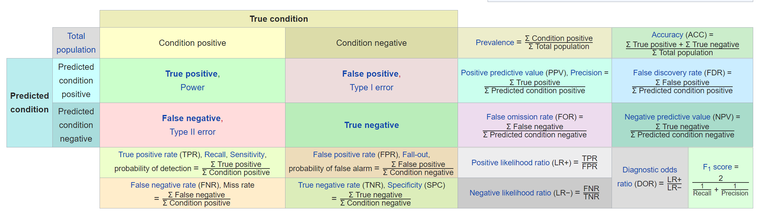

Slide 38
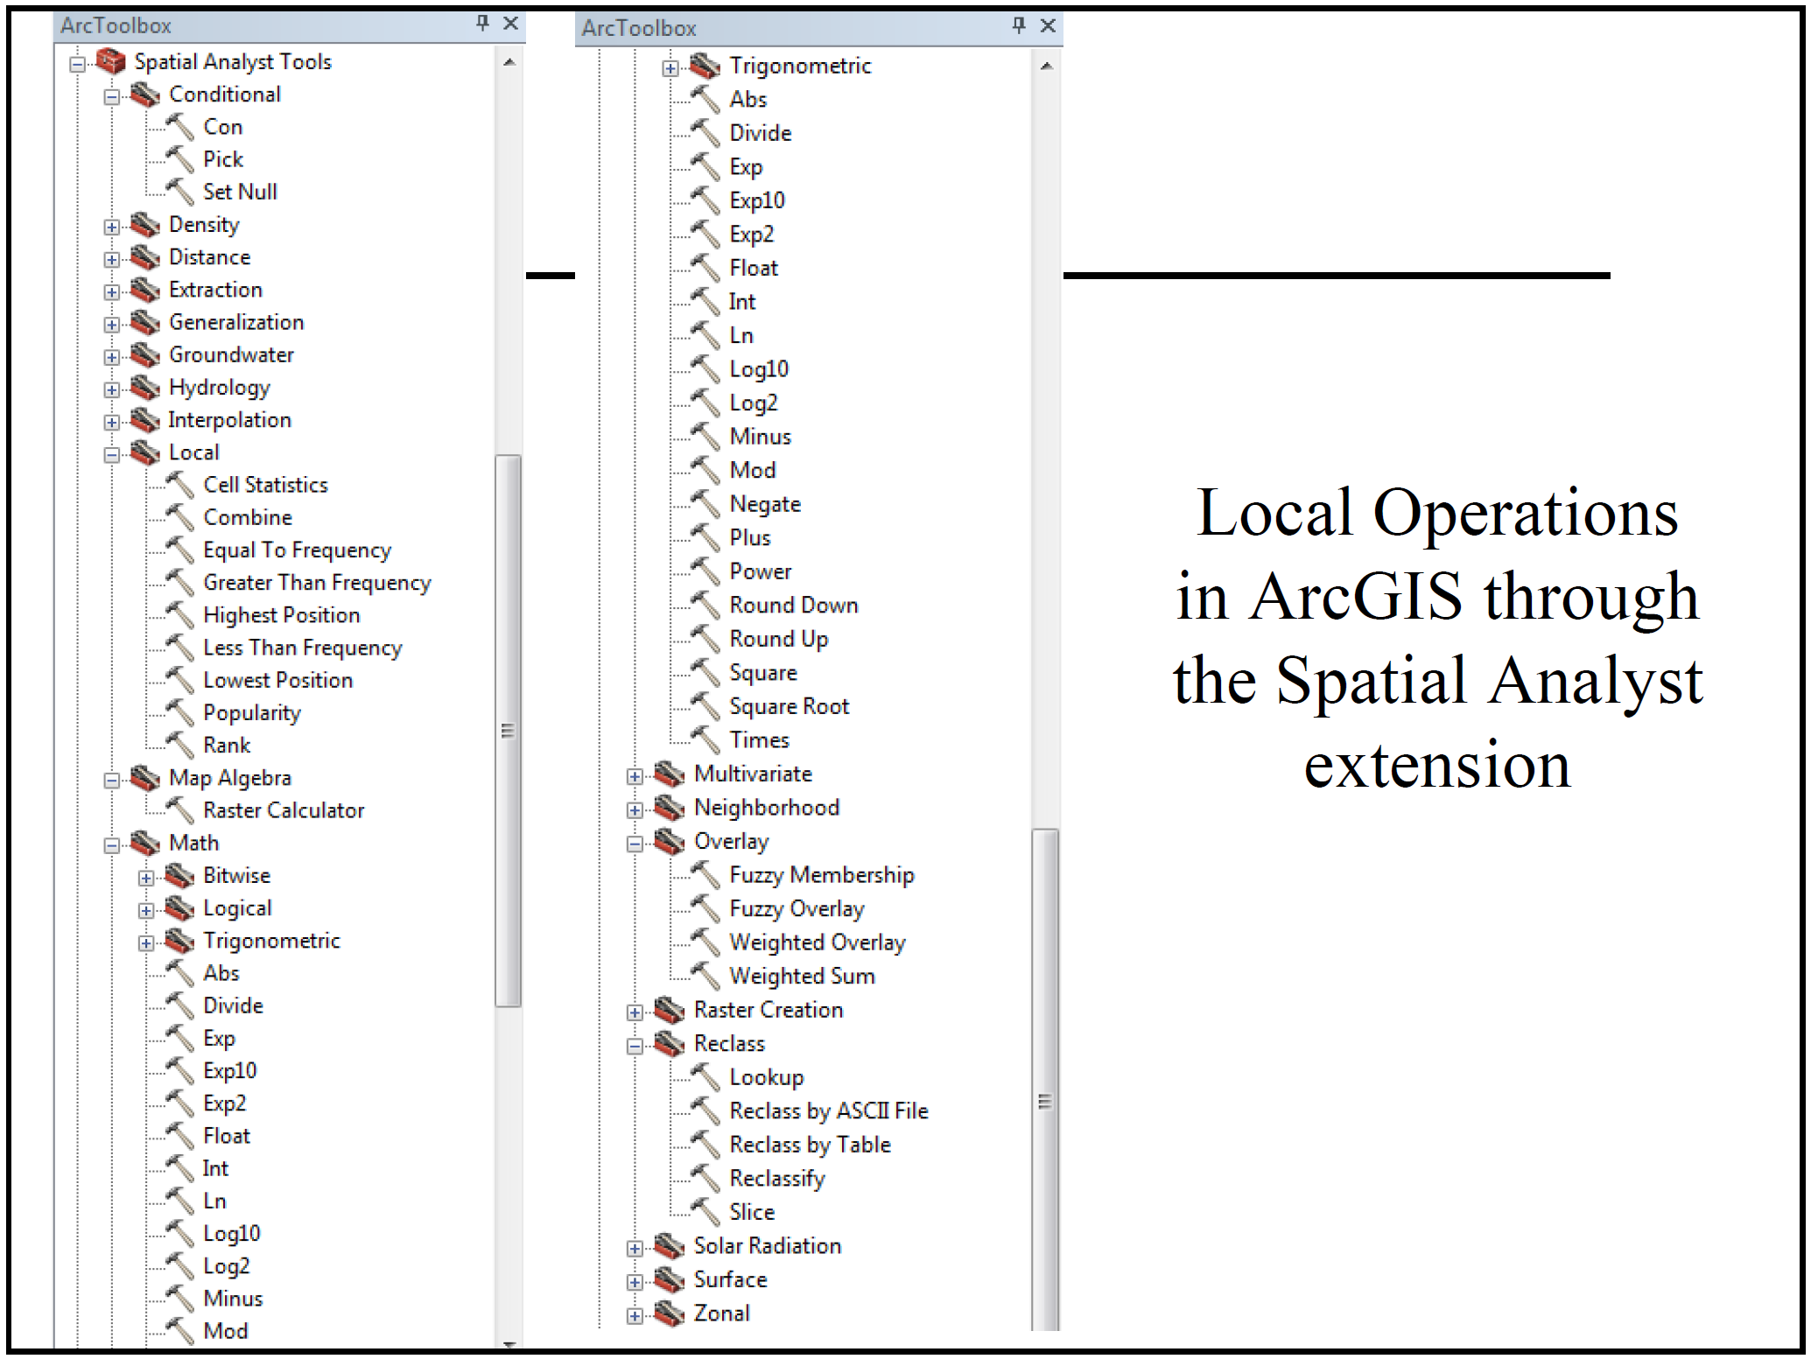

Slide 39
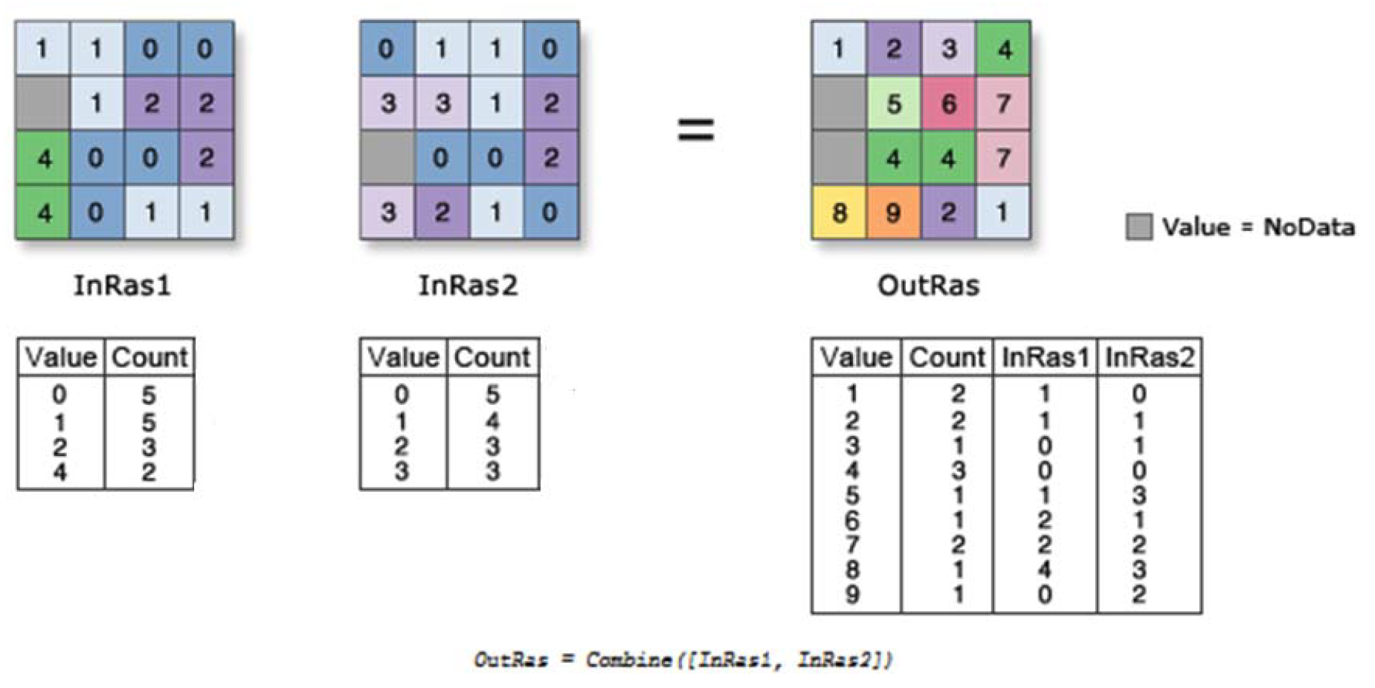

Slide 40

Acquired skills
Data Preparation
Analysis
Projection and registration
Vector to raster conversions
Interpolation
Take desired application and express it as a sequence of map algebra operations
Basic accuracy assessments

